Slide 1


模拟电子技术基础
Analog Device
8 Signal Processing
信号的处理
陈晓龙 Chen, Xiaolong
电子与电气工程系 E³

Slide 2







8.1 Filters 滤波
X
K
X
Filter
K

Slide 3
Based on the operating frequency:
Low pass filter 低通滤波
High pass filter 高通滤波
Band pass filter 带通滤波
Band Elimination filter 带阻滤波

Slide 4


















Ideal filters 理想滤波器
Low pass filter
High pass filter
Pass band
Stop band
Stop band
Pass band
通带
阻带
阻带
通带
0
0
Band pass filter
Band elimination filter
Stop band
Stop band
Pass band
Pass band
Pass band
Stop band
0
0

Slide 5



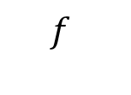
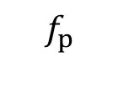
Real filters 实际滤波器
Low pass filter
Transition band
过渡区
Pass band
Stop band
0

Slide 6
Based on electronic components:
Passive filter circuits 无源滤波电路
Active filter circuits 有源滤波电路

Slide 7


Passive filter circuits 无源滤波电路
Made of resistors, capacitors and inductors
Simple
+
R
+
C
Merits
-
-
High frequency performance is better
Large load effect:负载效应大
Drawback
Space consumption: inductor has large size

Slide 8
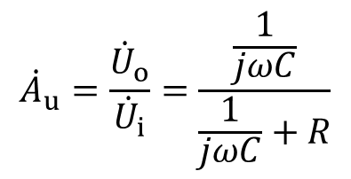

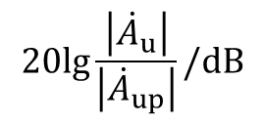
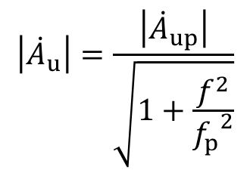




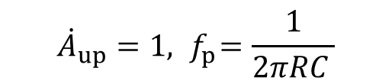
Passive filter circuits 无源滤波电路
+
R
+
C
-
-
Pass band
Stop band

Slide 9
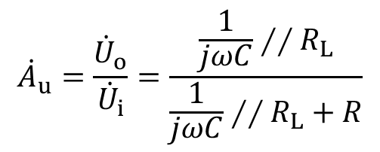


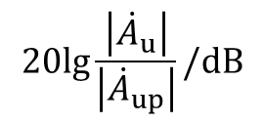
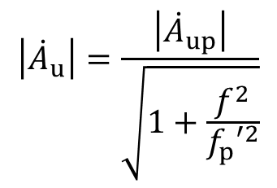





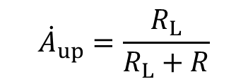
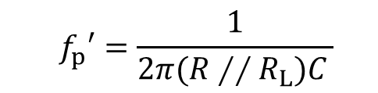
Passive filter circuits 无源滤波电路
+
R
+
C
-
-

Slide 10
Active filter circuits 有源滤波电路
Made of resistors, capacitors and active devices
Small size
Can amplifier signals in pass band
Merits
Small load effect 负载效应小
Can have multistage to realize high order filter circuits 可以多级相联，组成高阶滤波器

Slide 11
Active filter circuits 有源滤波电路
Made of resistors, capacitors and active devices
Pass band is narrow
Drawback
Need DC power supply
Applied in low-frequency, low voltage, low power circuits

Slide 12










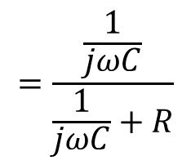

Active filter circuits 有源滤波电路
Use voltage follower to separate load resistor with filter circuits
+
R
+
C
-
-

Slide 13














8.2 Low pass active filters 低通有源滤波器
(1) First-order filters一阶滤波器
Laplace transform 拉氏变换
Real number
Complex number

Slide 14
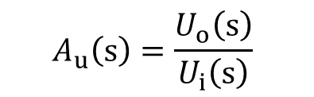




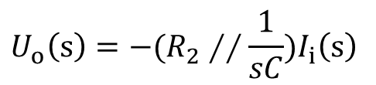



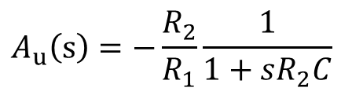
(1) First-order filters一阶滤波器
Transfer function 传递函数
Inverted input 反相输入

Slide 15
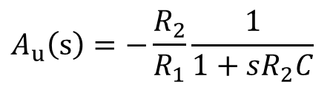




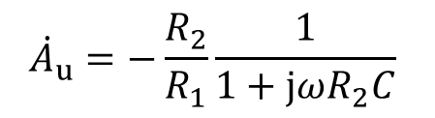


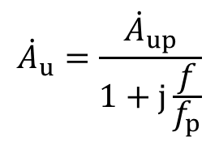
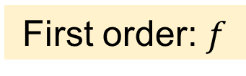
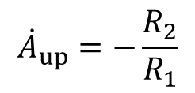
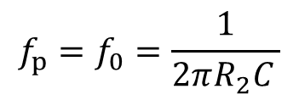
(1) First-order filters一阶滤波器

Slide 16












(1) First-order filters一阶滤波器
Inverted input 反相输入
Non-inverted input 同相输入

Slide 17

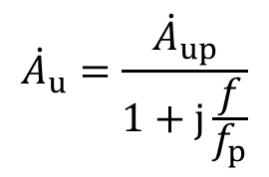




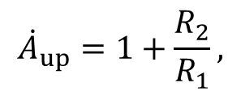
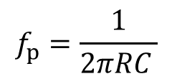


(1) First-order filters一阶滤波器
Non-inverted input 同相输入

Slide 18
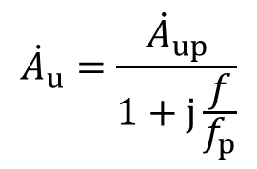


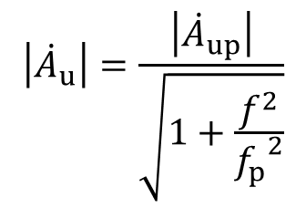



(1) First-order filters一阶滤波器
Pass band
-20dB/Dec
Amplitude frequency characteristic
3 dB
幅频特性

Slide 19
(1) First-order filters一阶滤波器
Merit: circuit is simple
Pass band
-20dB/Dec
3 dB
Drawback: slow signal attenuation: 20 dB/Dec
信号衰减慢

Slide 20



















(2) Second-order filters 二阶滤波器
Signal attenuation rate -20 dB/Dec
-40 dB/Dec

Slide 21

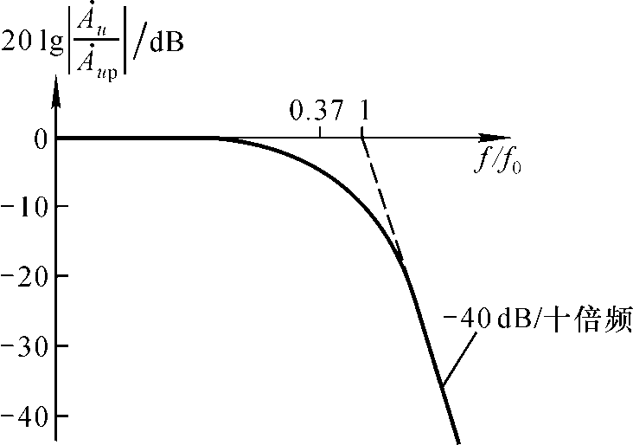







(2) Second-order filters 二阶滤波器

Slide 22














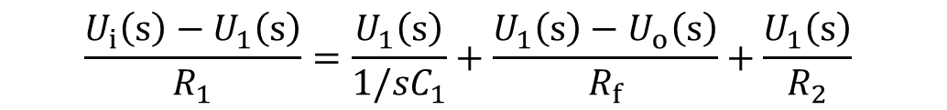
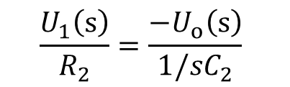
(2) Second-order filters 二阶滤波器
Transfer function 传递函数
Node 1 节点1:
Node 2 节点2:

Slide 23
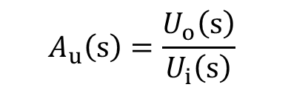
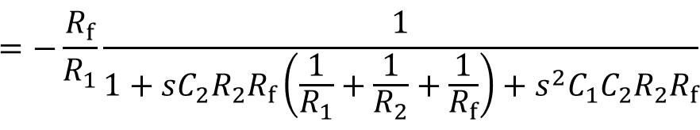

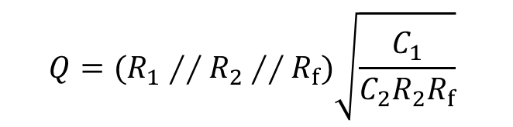
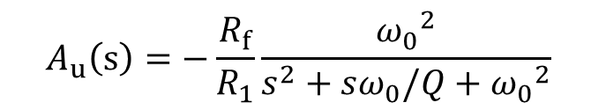
(2) Second-order filters 二阶滤波器
Transfer function 传递函数
Characteristic angular frequency特征角频率
Quality factor 品质因子

Slide 24

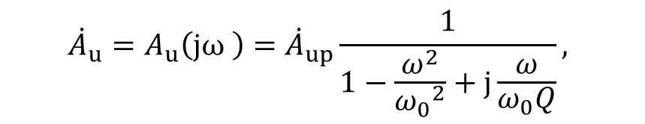
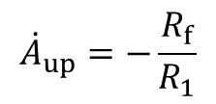
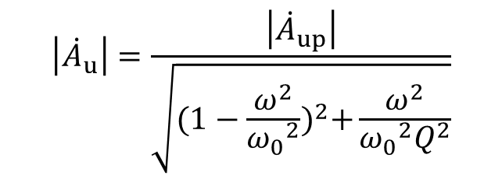
(2) Second-order filters 二阶滤波器
Frequency response
Amplitude frequency characteristic

Slide 25
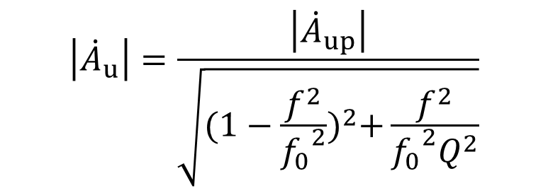
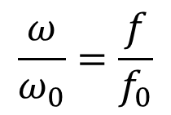
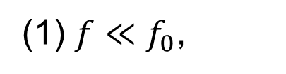

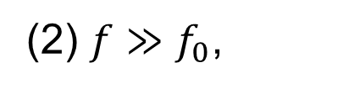

(2) Second-order filters 二阶滤波器
Amplitude frequency characteristic
Low pass filter!

Slide 26
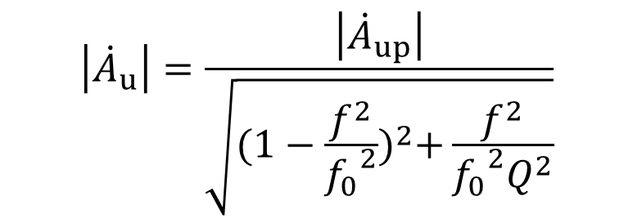

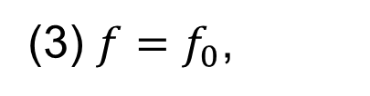

(2) Second-order filters 二阶滤波器
Amplitude frequency characteristic

Slide 27
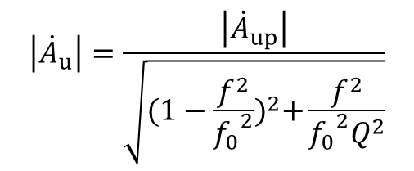
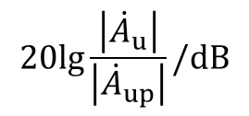
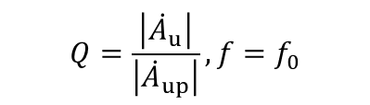









(2) Second-order filters 二阶滤波器
Amplitude frequency characteristic
-40dB/Dec

Slide 28
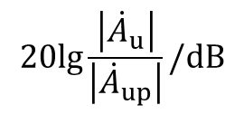













(2) Second-order filters 二阶滤波器
Amplitude frequency characteristic
-40dB/Dec

Slide 29









(2) Second-order filters 二阶滤波器
There is a peak
Larger Q, higher peak
Chebyshev filters
切比雪夫滤波器
-40dB/Dec

Slide 30


(2) Second-order filters 二阶滤波器
No peak
Signal attenuation in pass band is relatively large 通带信号衰减较大
Smaller Q, higher signal attenuation
-40dB/Dec
Bessel filter 贝塞尔滤波器

Slide 31


(2) Second-order filters 二阶滤波器
No peak
Signal attenuation in pass band is relatively large 通带信号衰减较大
Amplitude-frequency characteristic is flattest 幅频特性最平坦
Maximum flat filter /Butterworth filter 最大平坦/巴特沃斯滤波器
-40dB/Dec

Slide 32

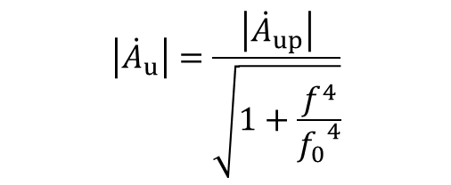


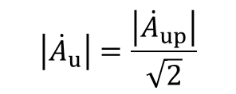
(2) Second-order filters 二阶滤波器
-40dB/Dec

Slide 33




8.2 High pass active filters 高通有源滤波器
(1) First-order filters一阶滤波器
+
R
+
+
C
+
C
R
-
-
-
-
Low pass
High pass

Slide 34



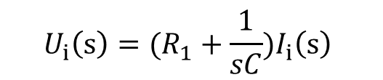


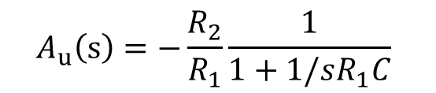
(1) First-order filters一阶滤波器
Transfer function 传递函数
Inverted input 反相输入

Slide 35









(1) First-order filters一阶滤波器

Slide 36





(1) First-order filters一阶滤波器
Pass band
Amplitude frequency characteristic
3 dB
幅频特性
-20dB/Dec

Slide 37











(2) Second-order filters 二阶滤波器
Signal attenuation rate 20 dB/Dec
40 dB/Dec

Slide 38















(2) Second-order filters 二阶滤波器
Transfer function 传递函数?
Node 1 节点1:
Node 2 节点2:

Slide 39





(2) Second-order filters 二阶滤波器
Transfer function 传递函数

Slide 40





(2) Second-order filters 二阶滤波器
Transfer function 传递函数
特征角频率
Quality factor 品质因子

Slide 41





(2) Second-order filters 二阶滤波器
Frequency response
Amplitude frequency characteristic

Slide 42










(2) Second-order filters 二阶滤波器
Amplitude frequency characteristic
-40dB/Dec

Slide 43



8.3 Band pass active filters 带通有源滤波器
Low pass filter
High pass filter

Slide 44




















High Pass filter
Band Pass filter

Slide 45














Transfer function 传递函数?
Node 1 节点1:
Node 2 节点2:

Slide 46





Transfer function 传递函数

Slide 47




Frequency response:
Amplitude frequency characteristic

Slide 48







Band pass filter!

Slide 49




Cut-off frequency

Slide 50




Bandwidth
Larger Q, smaller bandwidth, better selectivity.
Q值越大，带宽越小，选择性越好

Slide 51















Slide 52


8.3 Band elimination active filters 带阻有源滤波器
Low pass filter
Addition
High pass filter

Slide 53


























Band elimination active filters

Slide 54

















Node 1 节点1:
Node 2 节点2:
Node 3 节点3:

Slide 55





Transfer function 传递函数

Slide 56



Frequency response:
Amplitude frequency characteristic

Slide 57







Band elimination filter!

Slide 58





Bandwidth

Slide 59

Q large
Q=1
Q small

Slide 60
Homework：refer to blackboard

